Slide 1
Numerical Analysis (5/7) Ordinary Differential equations
University of Luxembourg - 2024
Master in Mathematics
Hadrien Beriot

Slide 2
Outline
1. Introduction
2. Euler Methods
3. One step methods
4. Multi-step methods
5. Additional considerations
6. Summary

Slide 3

1. Introduction

Slide 4
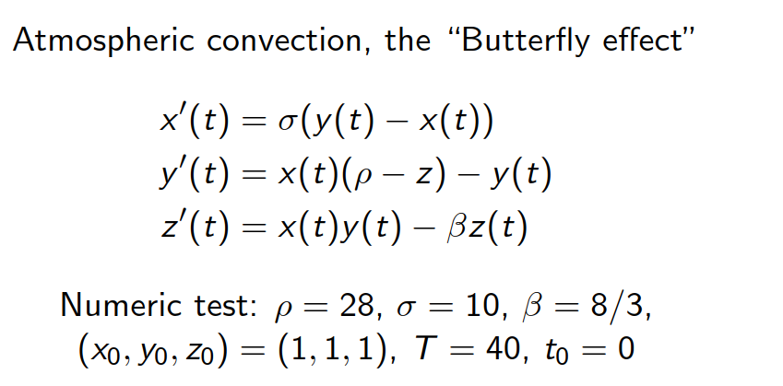
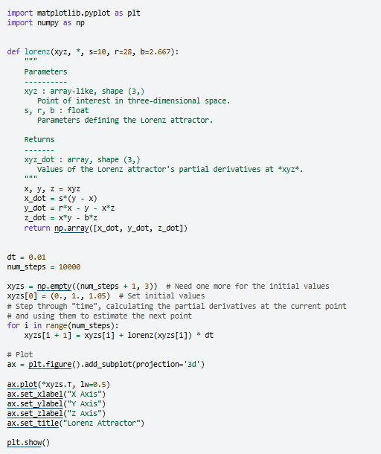
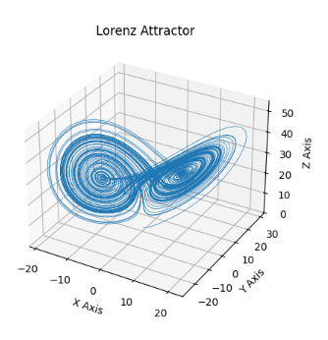
A famous example – The Lorenz system
https://matplotlib.org/stable/gallery/mplot3d/lorenz_attractor.html
Notes:
The image represents a Lorenz attractor, which is a three-dimensional chaotic attractor discovered by the mathematician Edward Lorenz.
The Lorenz attractor is a graphical representation of the solutions to a set of differential equations that describe a simplified model of atmospheric convection, known as the "Butterfly effect".
The image shows the characteristic butterfly-like shape of the Lorenz attractor, which demonstrates the sensitive dependence on initial conditions that is a hallmark of chaotic systems.

Slide 5
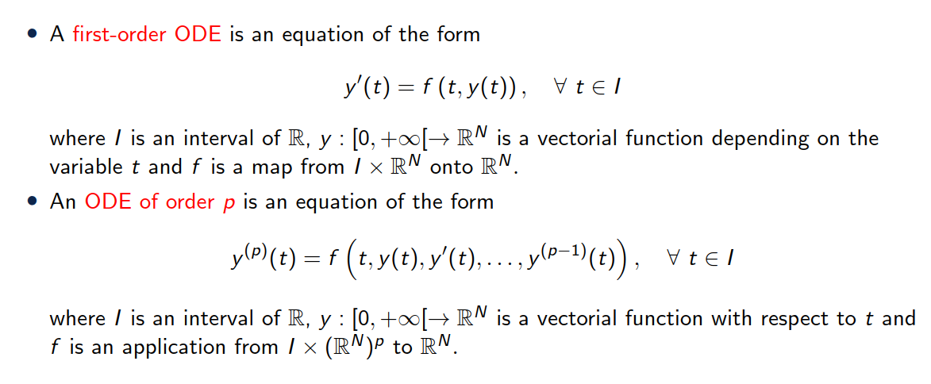
Definition

Slide 6
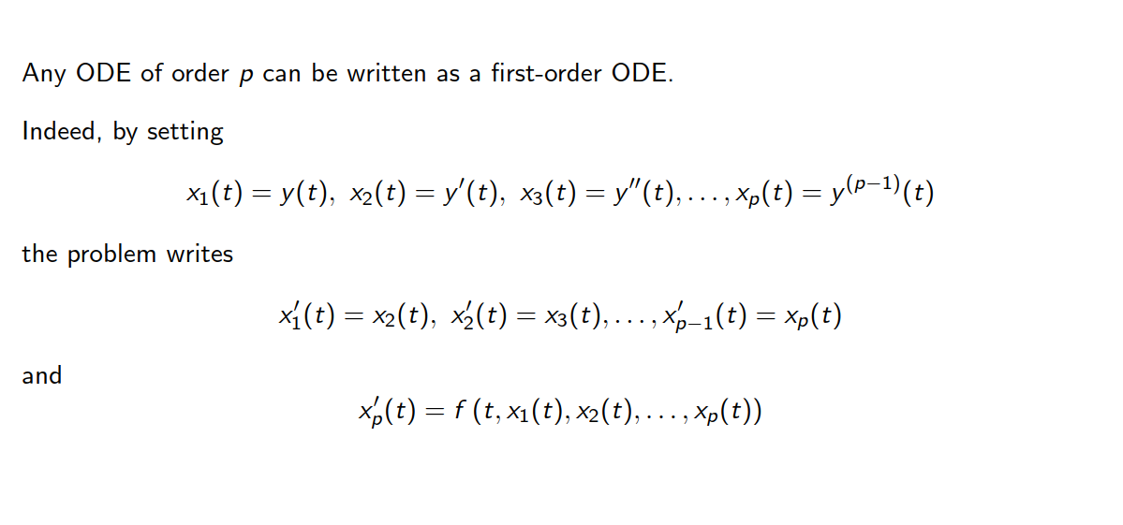
Remark

Slide 7
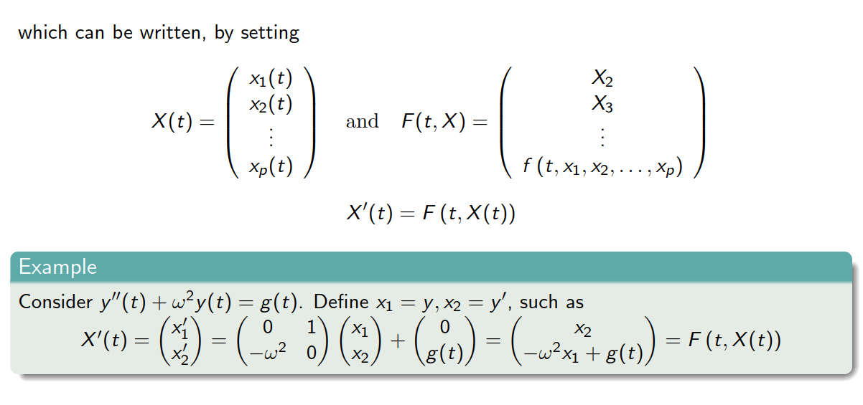
Remark

Slide 8
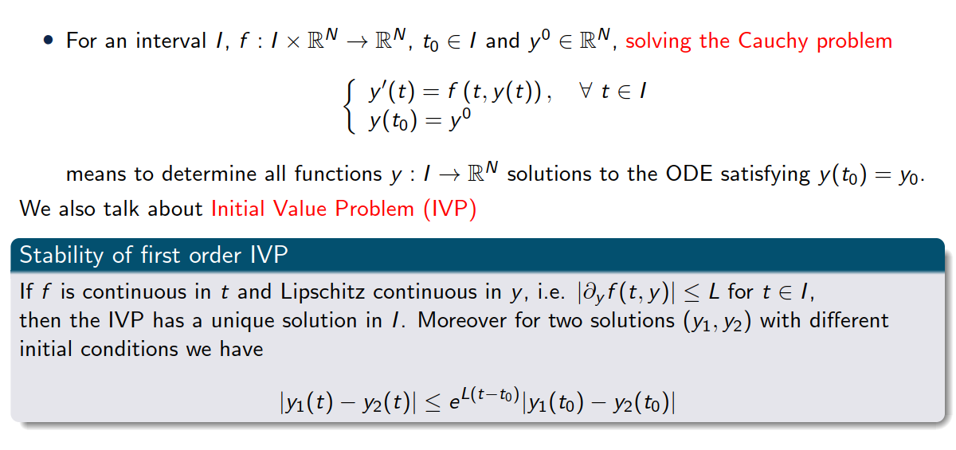
Definition – Initial Value Problem

Slide 9



Take away
Continuously differentiable
Lipschitz
Continuous
Continuous
Lipschitz ➔ limited in how fast in can change (bounded derivative)
$f(t,u)$ continuous in $t$
$f(t,u)$ Lipschitz continuous in $u$

Slide 10
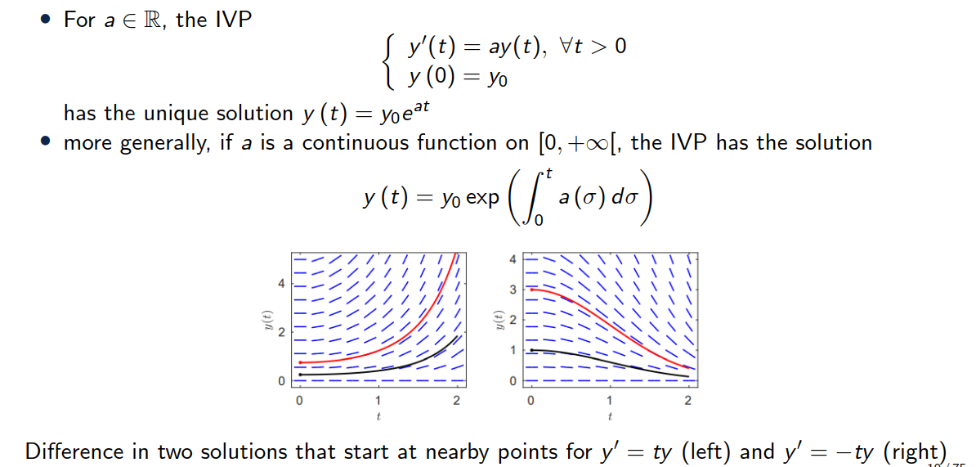
A simple example

Slide 11

Examples of ODEs
Linear ODE: $u′ = −2u$ $⇒$solution is $u(t) =C_{0}e^{−2t}$
Separable ODE: $u′ = u²$ $⇒$solution is $u(t) = 1 / (C₀ − t)$
Logistic Growth Model: $u′ = u(1 − u)$ $⇒$solution is $u\left(t\right)=C_{0}e^{t}/\left(1 +C_{0}e^{t}\right)$
Exponential Growth/Decay: $u^{′}= −ku⇒$ solution is $u(t) =C_{0}e^{−kt}$
Harmonic Oscillator: $u′′ = −ω²u$ $⇒$ solution is $u(t) = C₁cos⁡(ωt) + C₂sin⁡(ωt)$
Pendulum: $u^{′′}+\frac{l}{g​}\sin\left(u\right)=0⇒$ closed form only for small displacements $\sin\left(u\right)≈u$ (Harmonic oscillator)
Riccatti: $u^{′}=a\left(t\right)+b\left(t\right)u+c\left(t\right)u^{2} ⇒$ no closed form solution
These ODEs appear in a variety of disciplines such as physics, biology, engineering, and economics
$C_{0}$, $C_{1}$, $C_{2}$ are the constants of integration

Slide 12
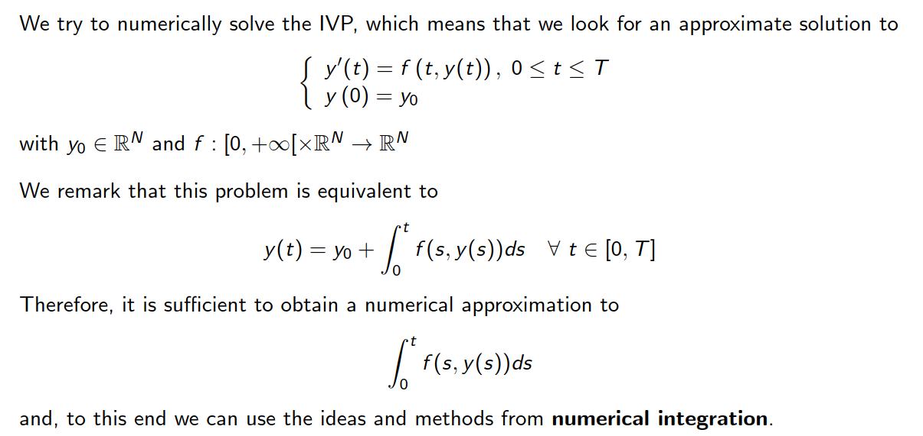
Numerical approximation

Slide 13
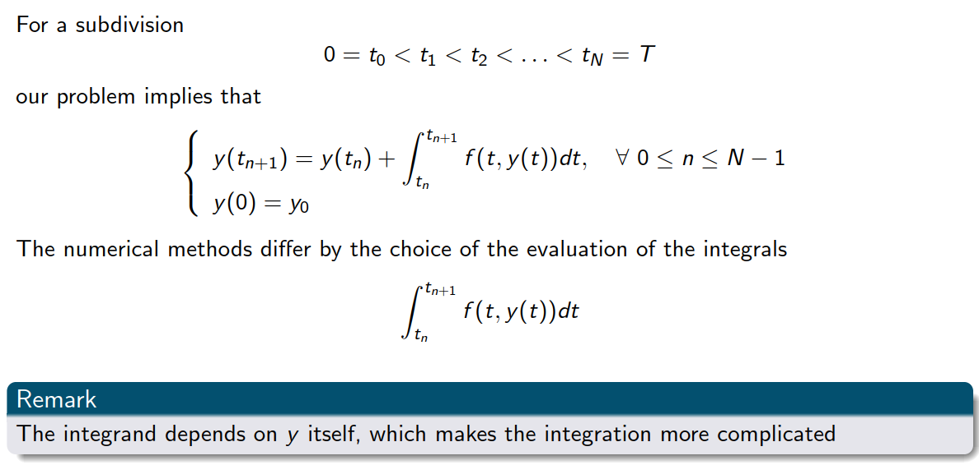
Numerical approximation

Slide 14
2. Euler Methods

Slide 15
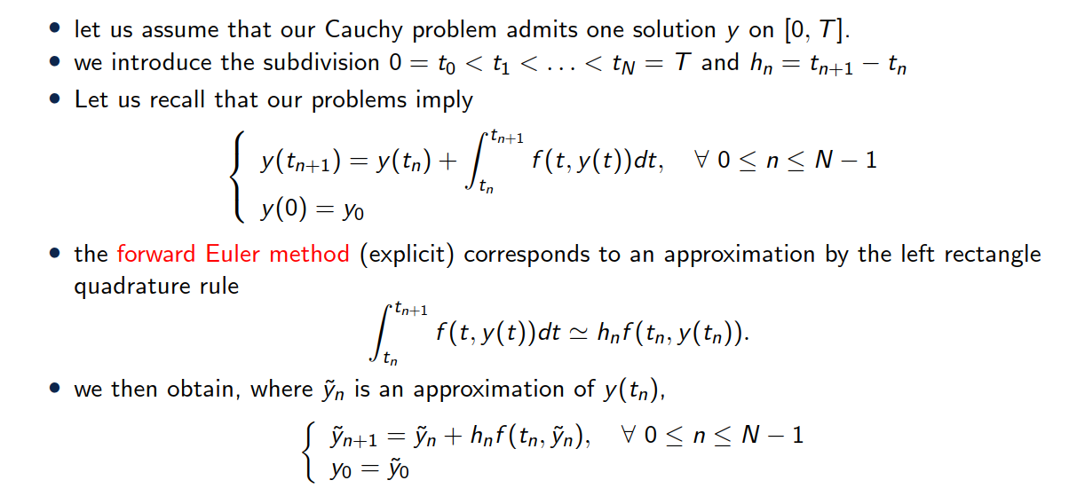
The forward Euler problem

Slide 16
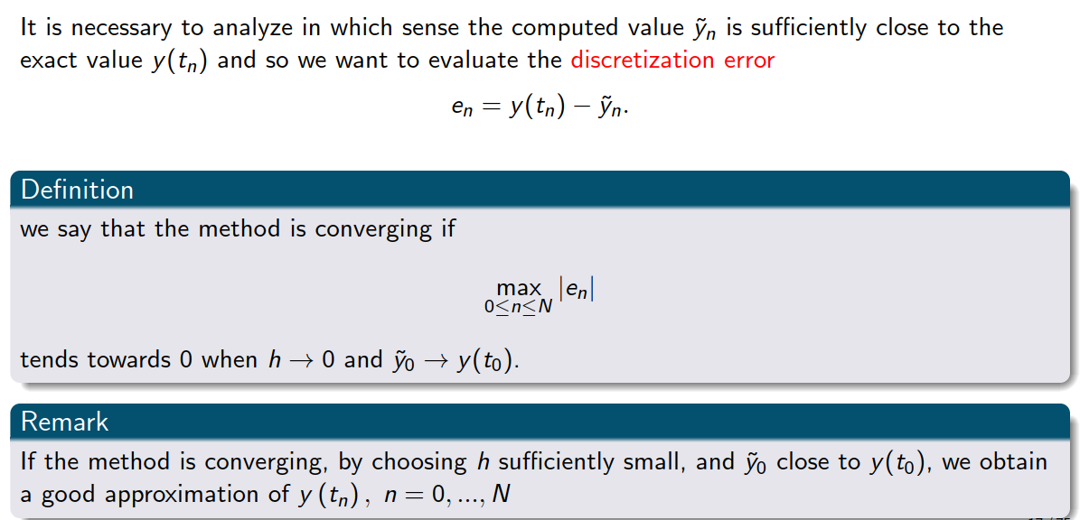
Convergence

Slide 17
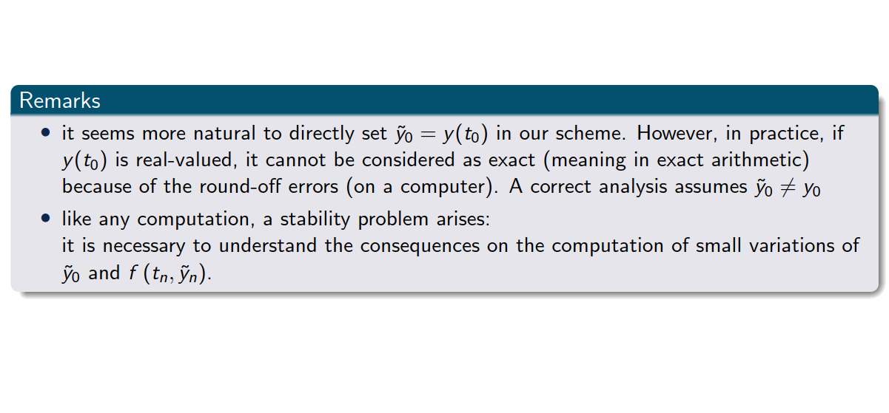
Convergence

Slide 18
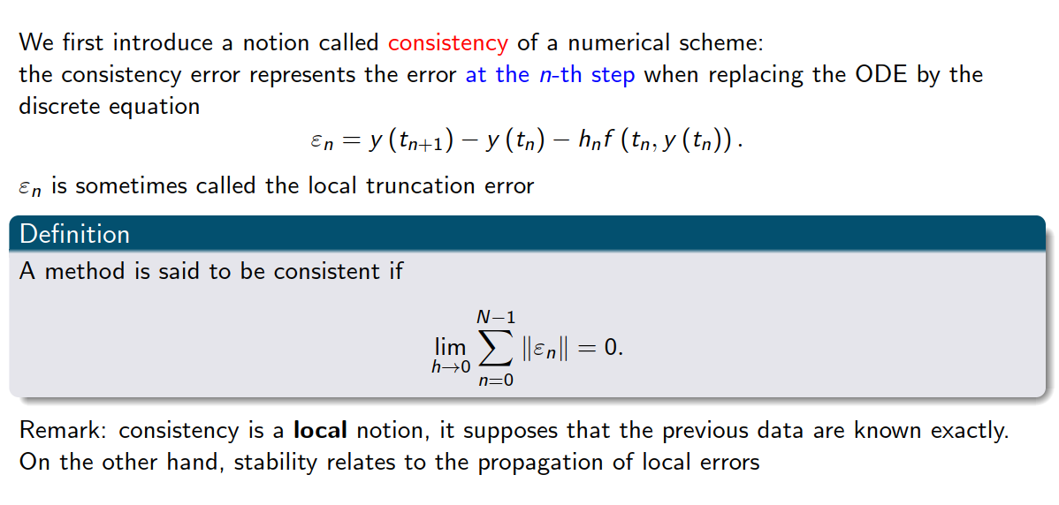
Consistency

Slide 19
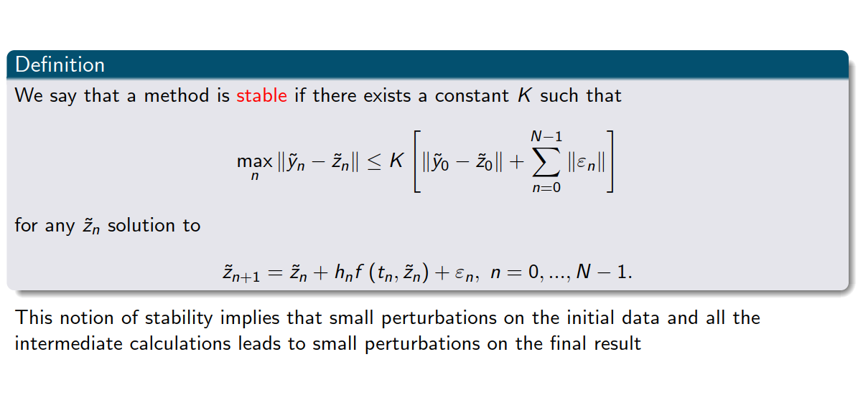
Stability

Slide 20
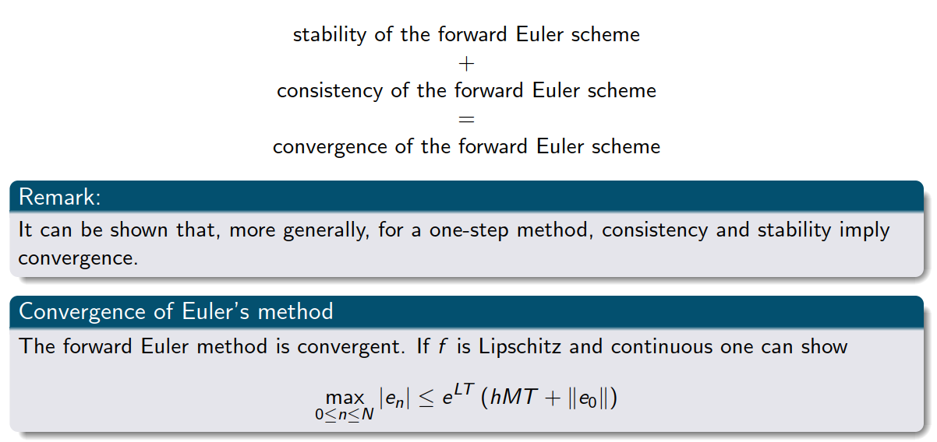
Back to convergence

Slide 21
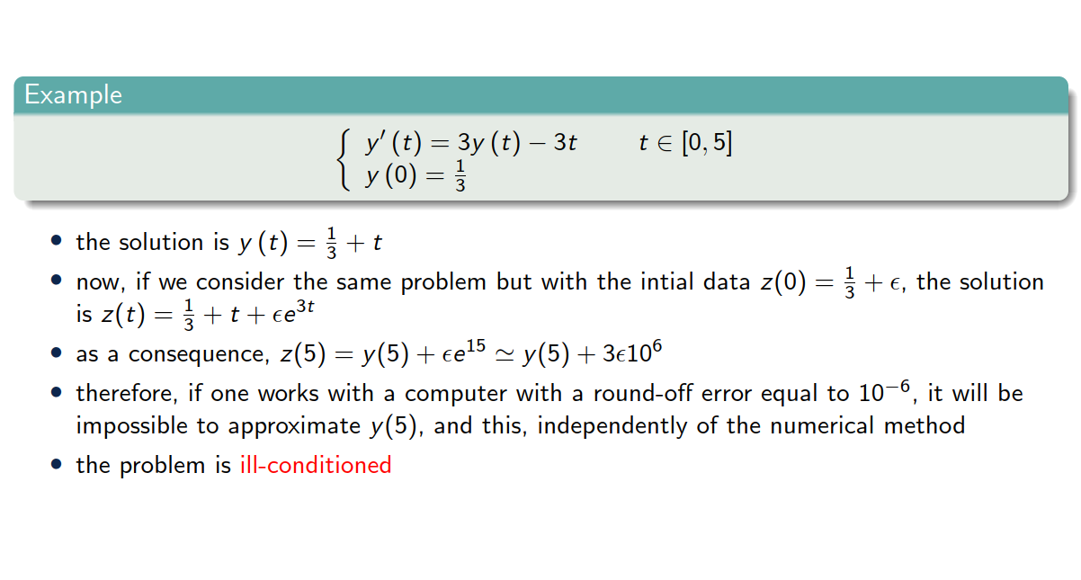
Example 1

Slide 22
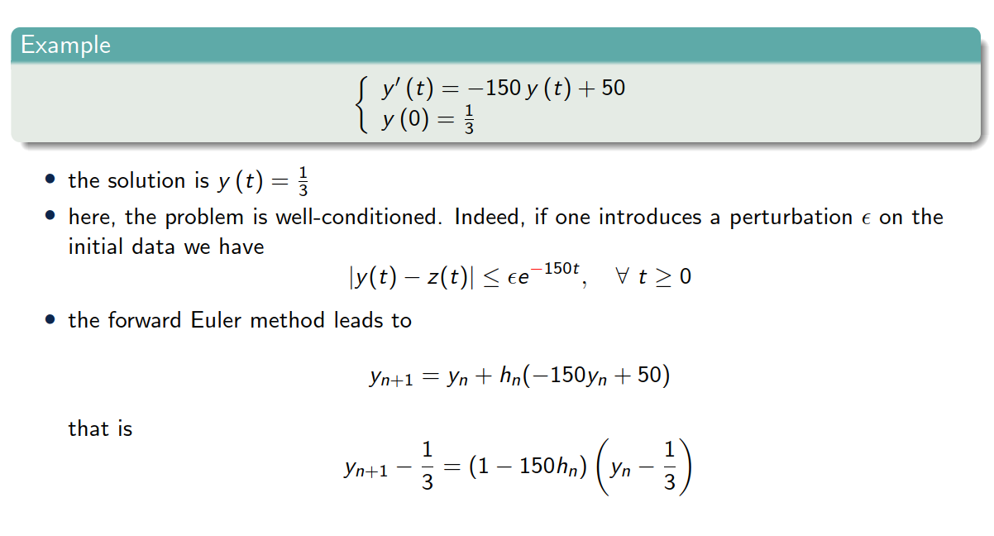
Example 2

Slide 23
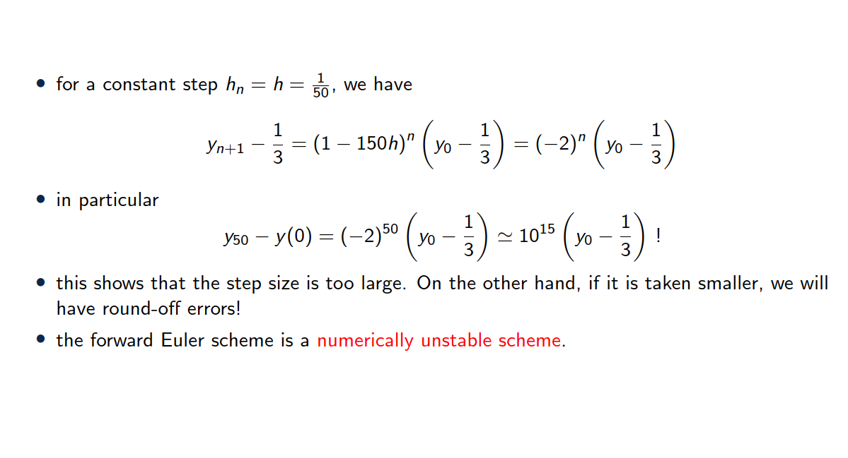
Example 2

Slide 24
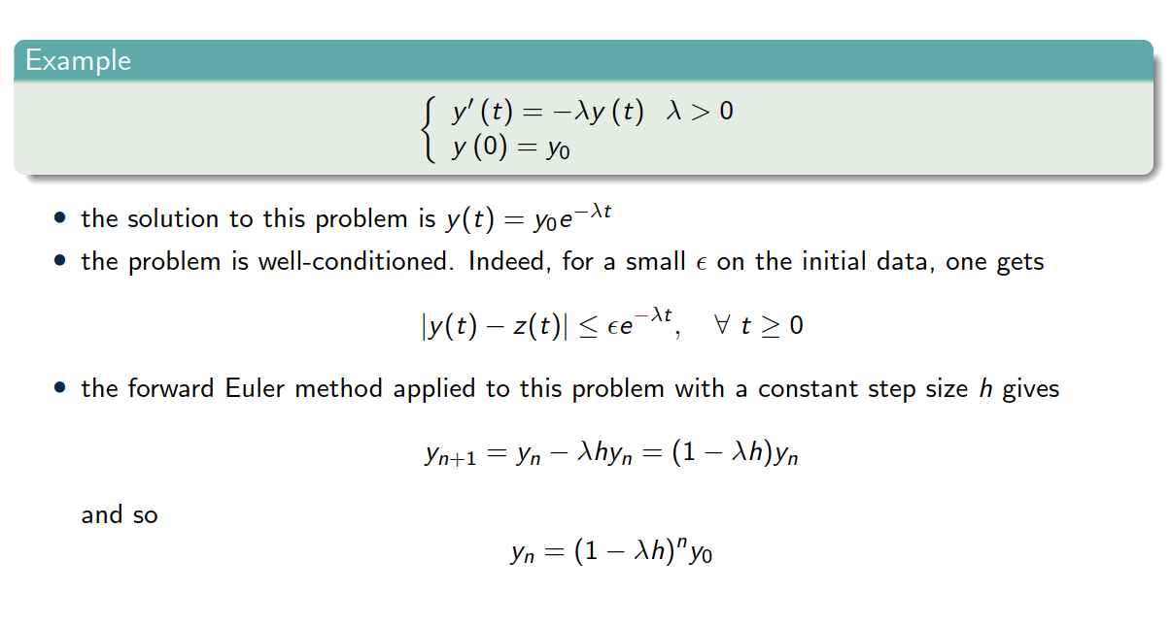
Example 3

Slide 25
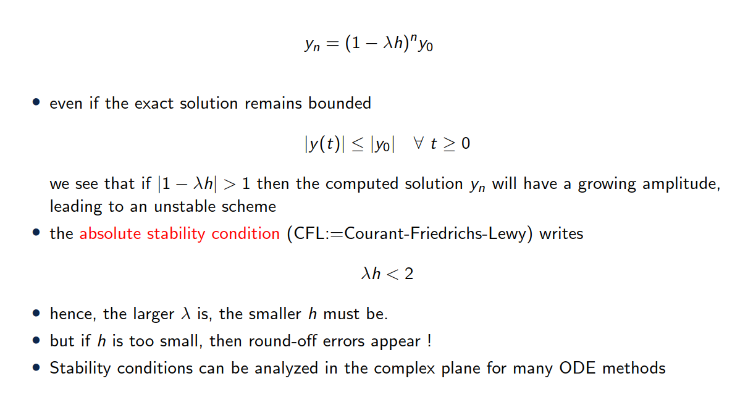
Example 3

Slide 26
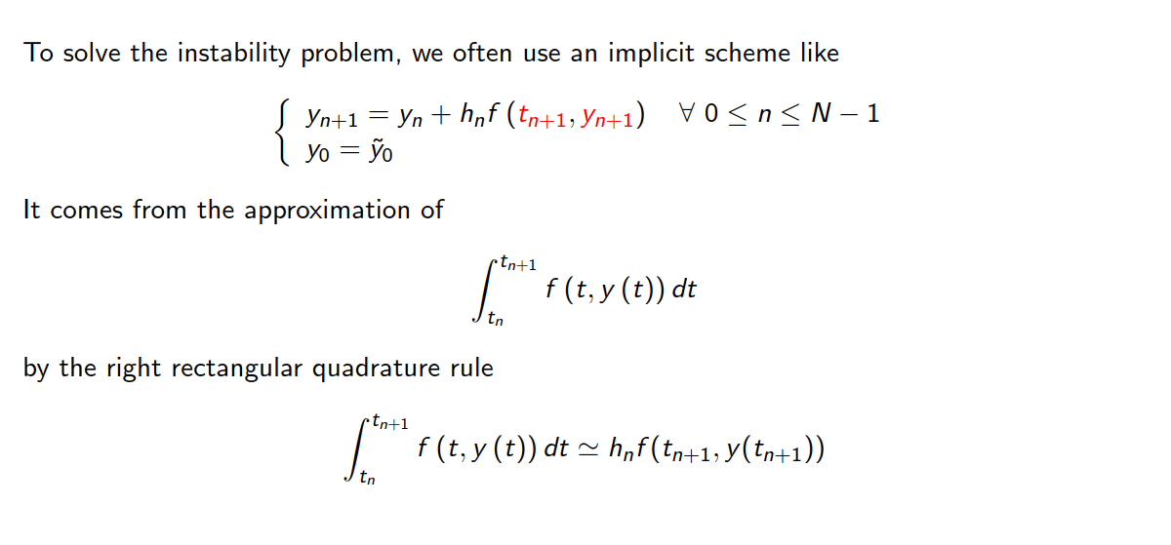
Backward Euler (implicit)

Slide 27
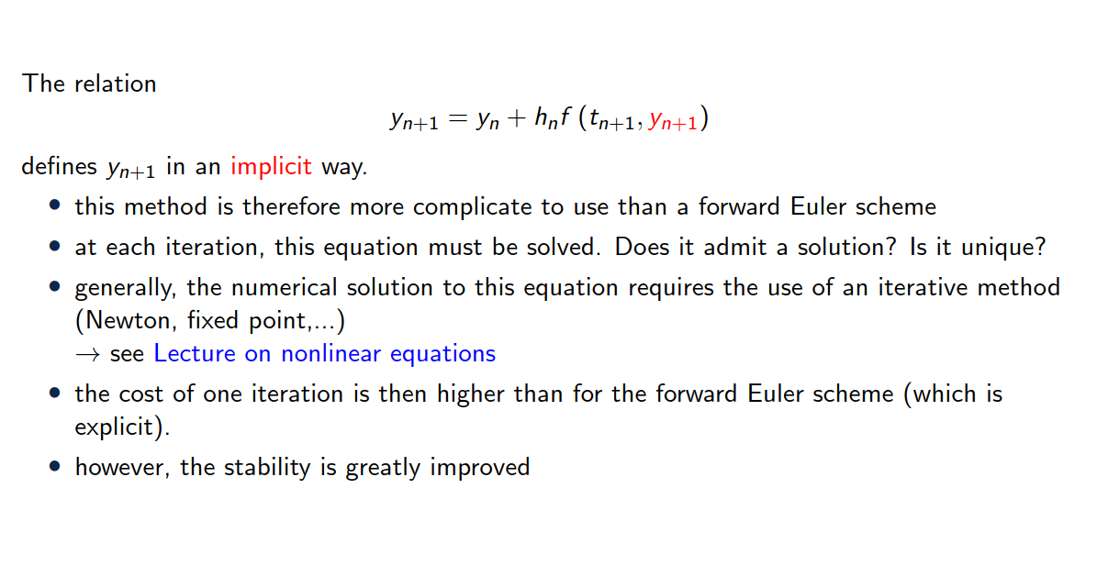
Backward Euler (implicit)

Slide 28
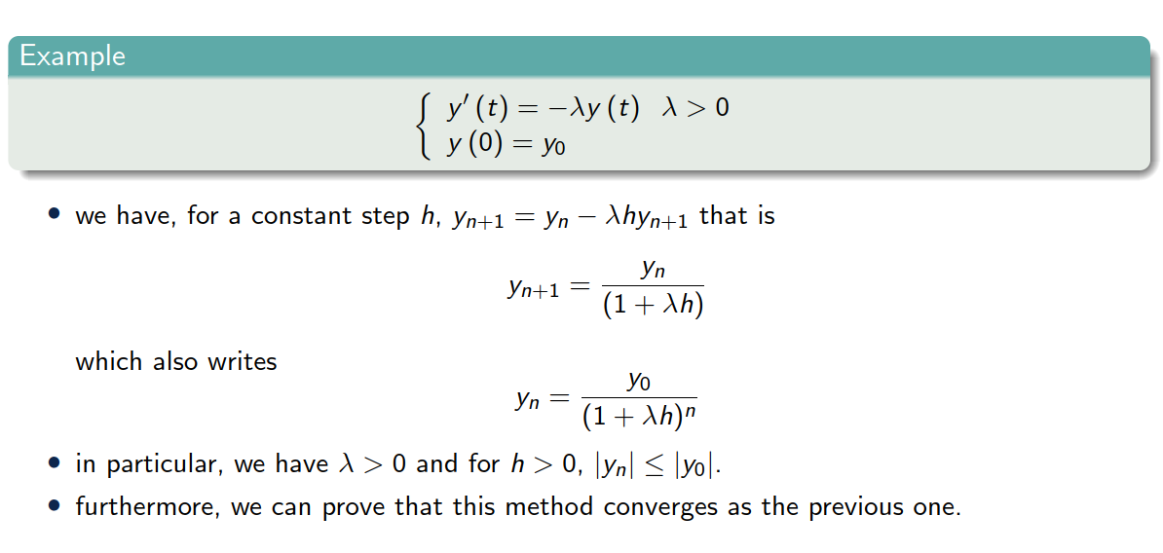
Back to example 3

Slide 29
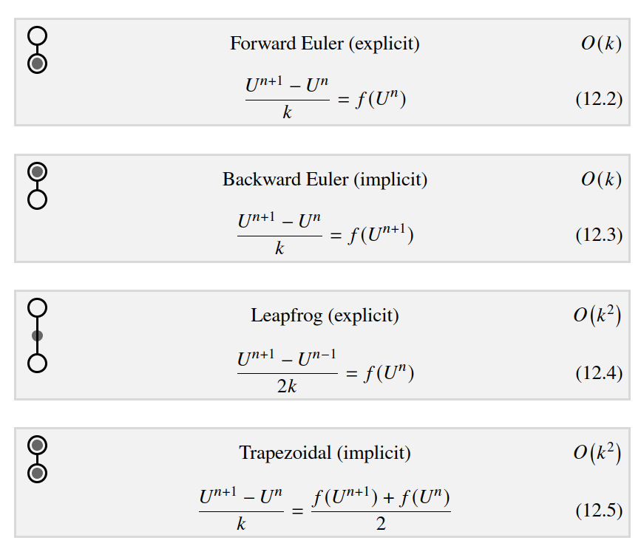
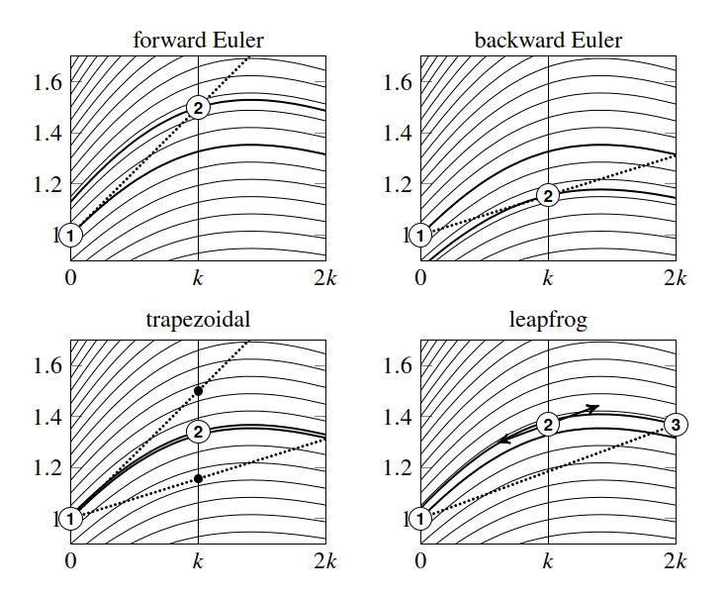


Single step methods
Integral curves
Exercise 1

Slide 30
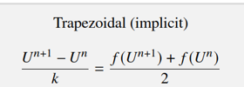
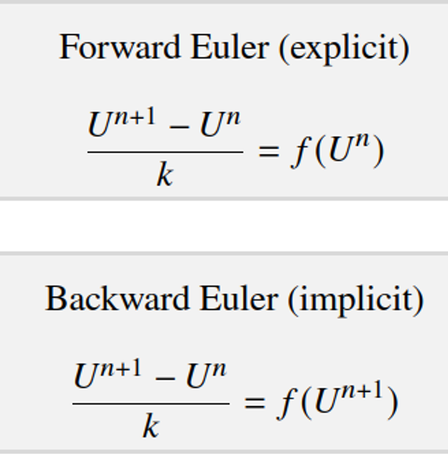





















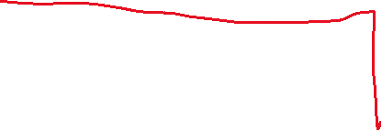





Slide 31
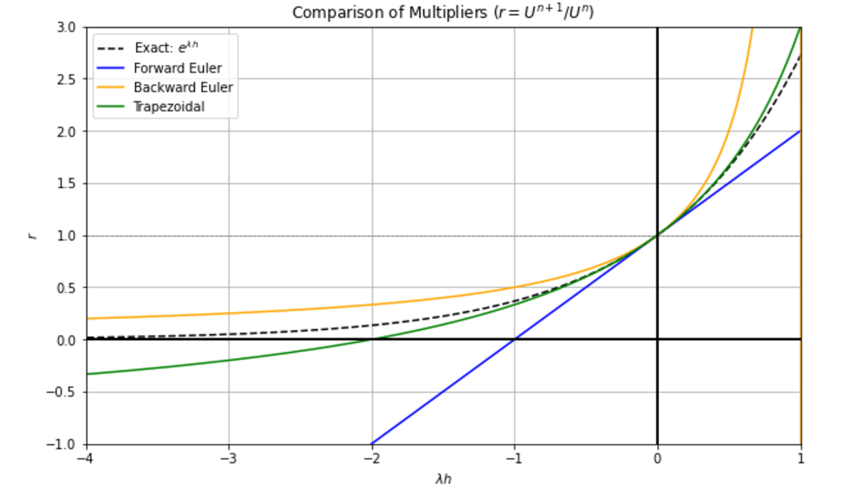
Accuracy of the different schemes for $u’ =λ u$

Slide 32
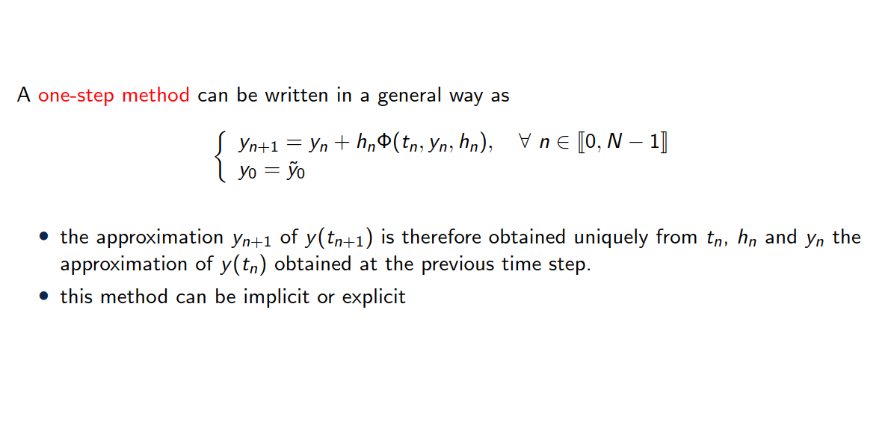
General study of one-step methods

Slide 33
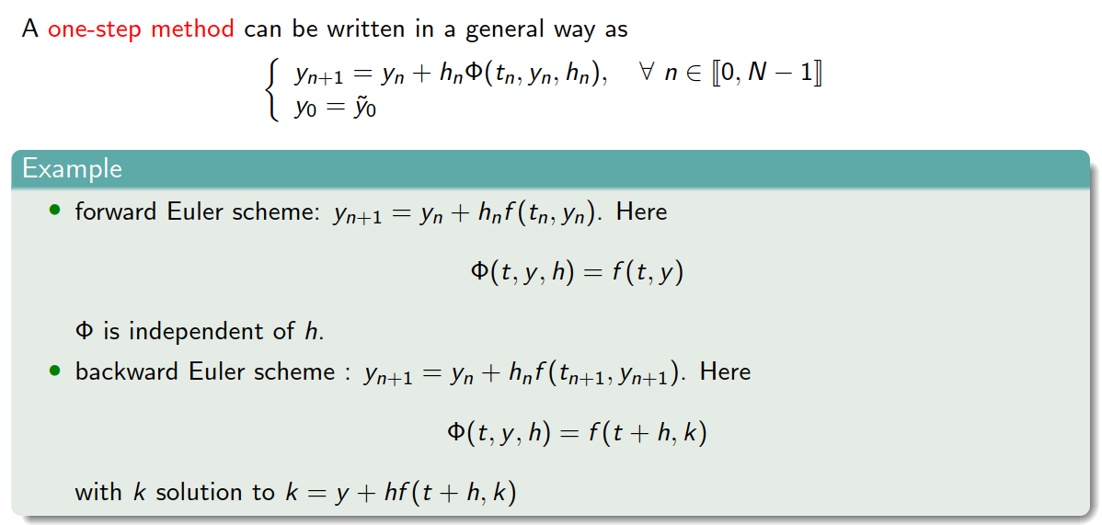
General study of one-step methods

Slide 34
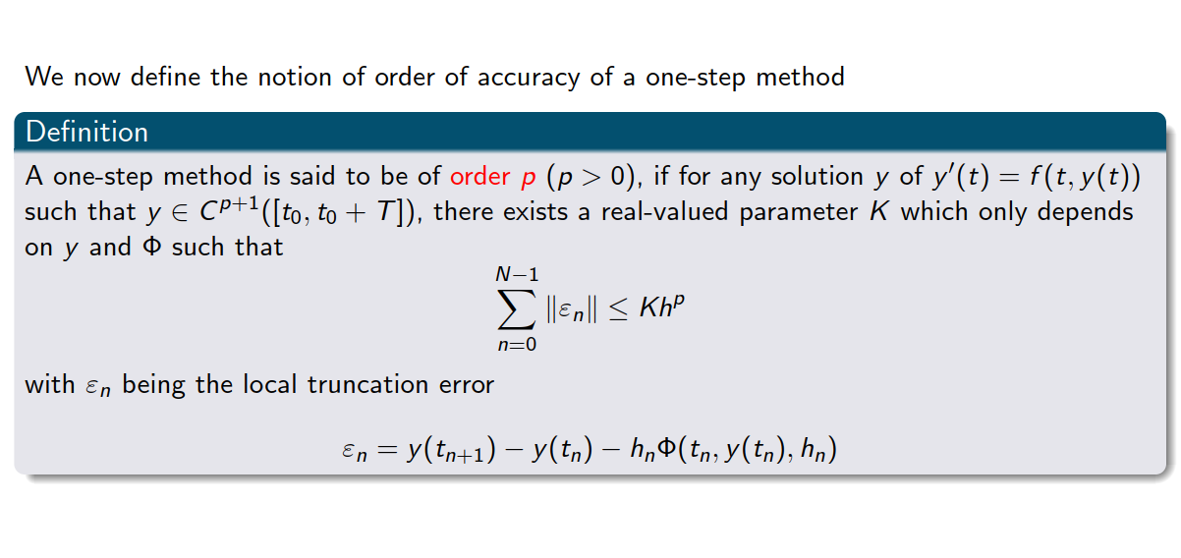
Order of accuracy

Slide 35
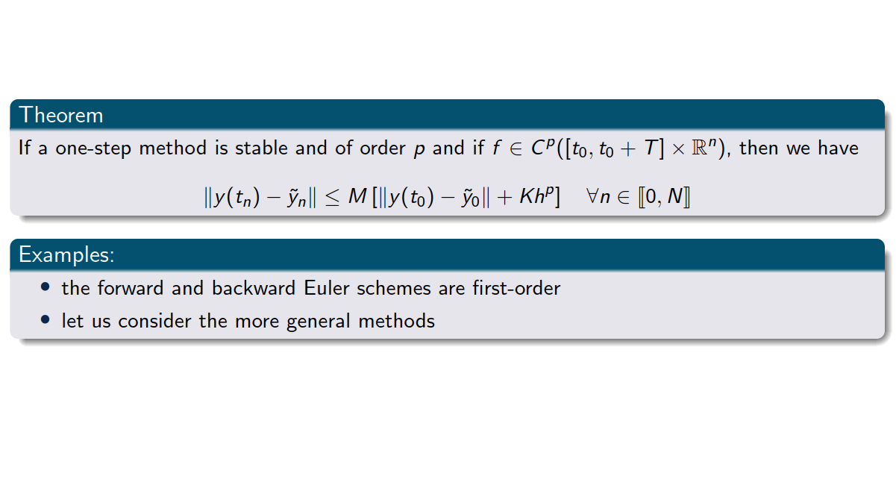
Order of accuracy
Exercise 2 – logistic equation

Slide 36
3. Runge Kutta methods

Slide 37
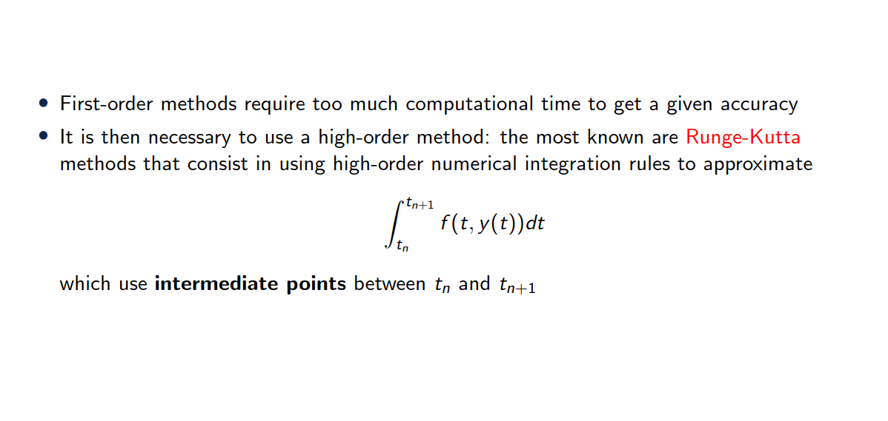
Runge-Kutta methods

Slide 38


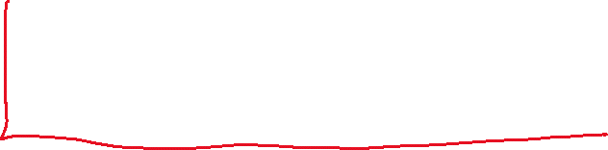


Idea = integrate the ODE + use quadrature

Slide 39











Idea = integrate the ODE + use quadrature

Slide 40





Idea = integrate the ODE + use quadrature

Slide 41
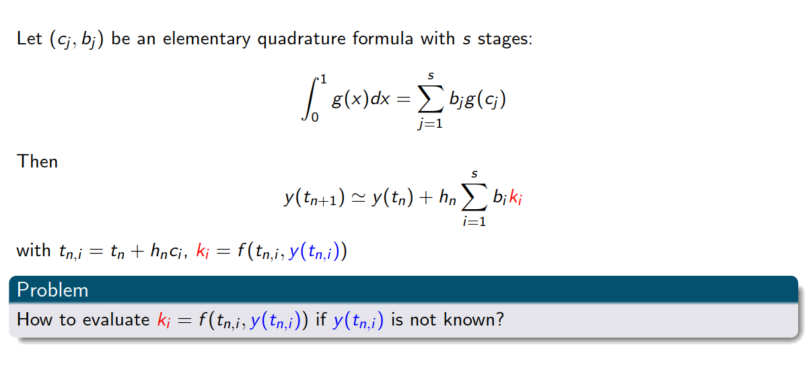
Runge-Kutta methods

Slide 42
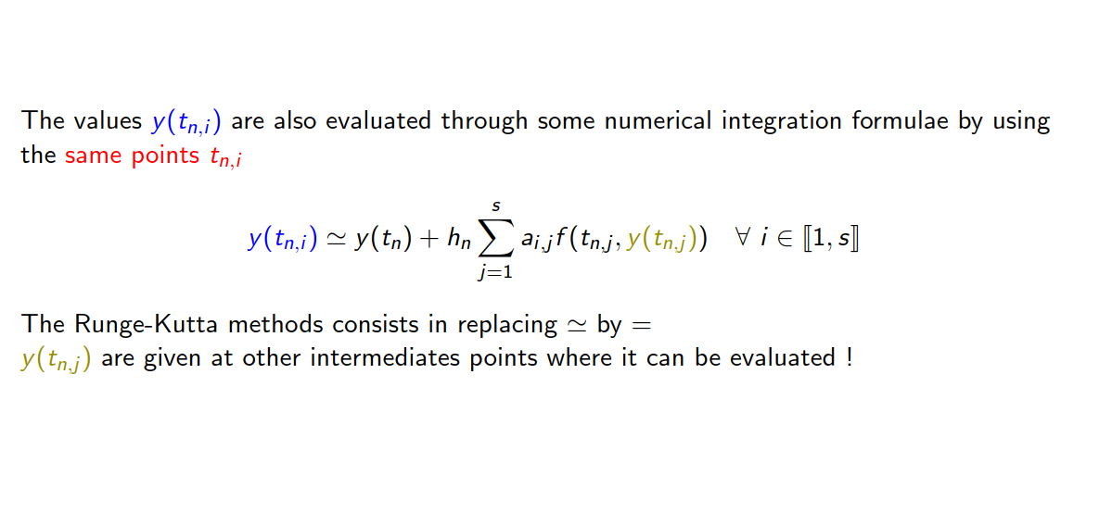
Runge-Kutta methods

Slide 43
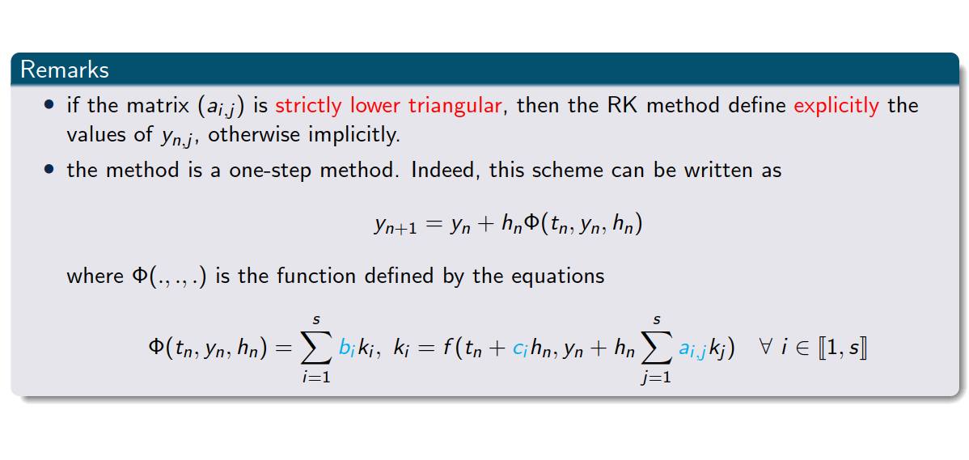
Runge-Kutta methods

Slide 44
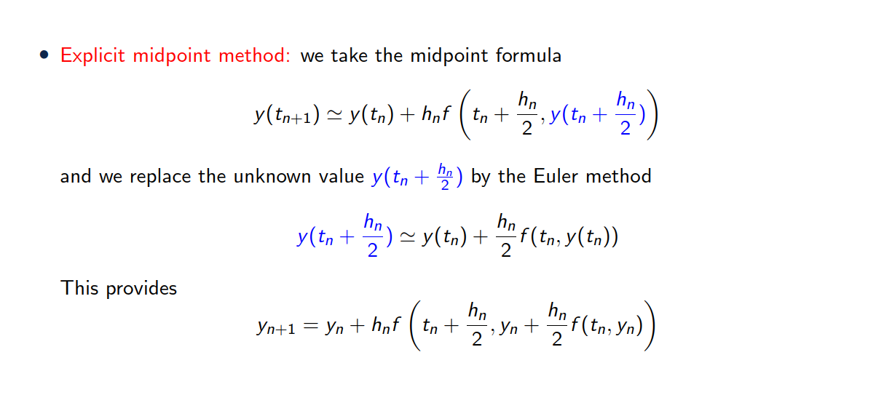
Examples of Runge Kutta method

Slide 45
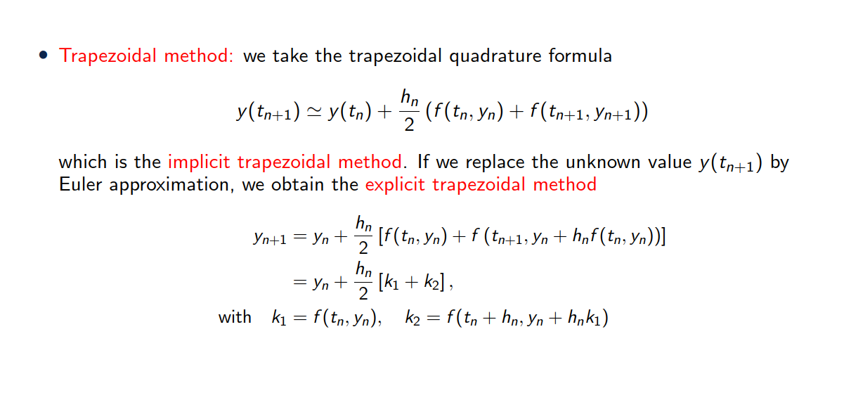

Examples of Runge Kutta method

Slide 46

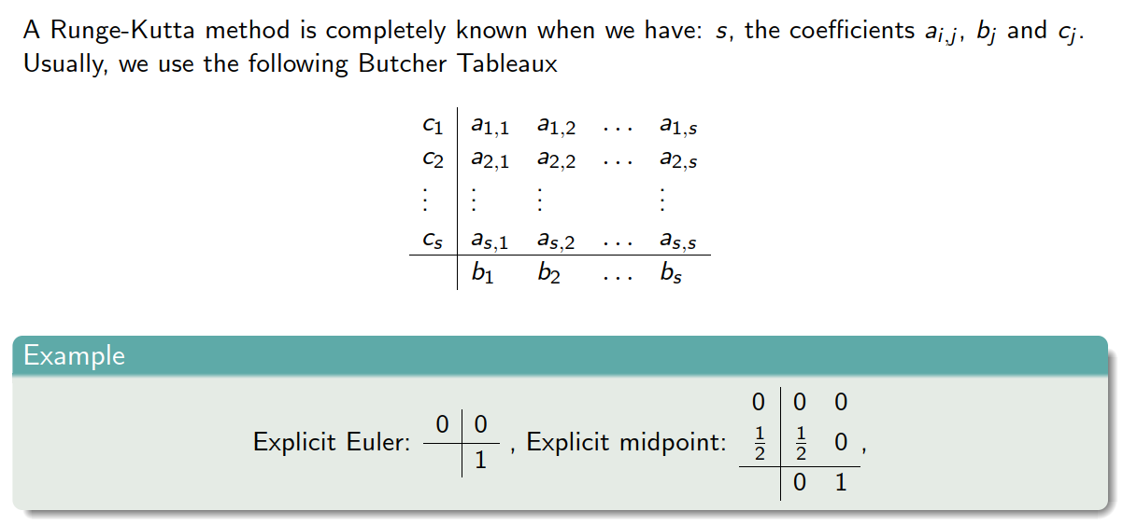




Butcher Tableau

Slide 47
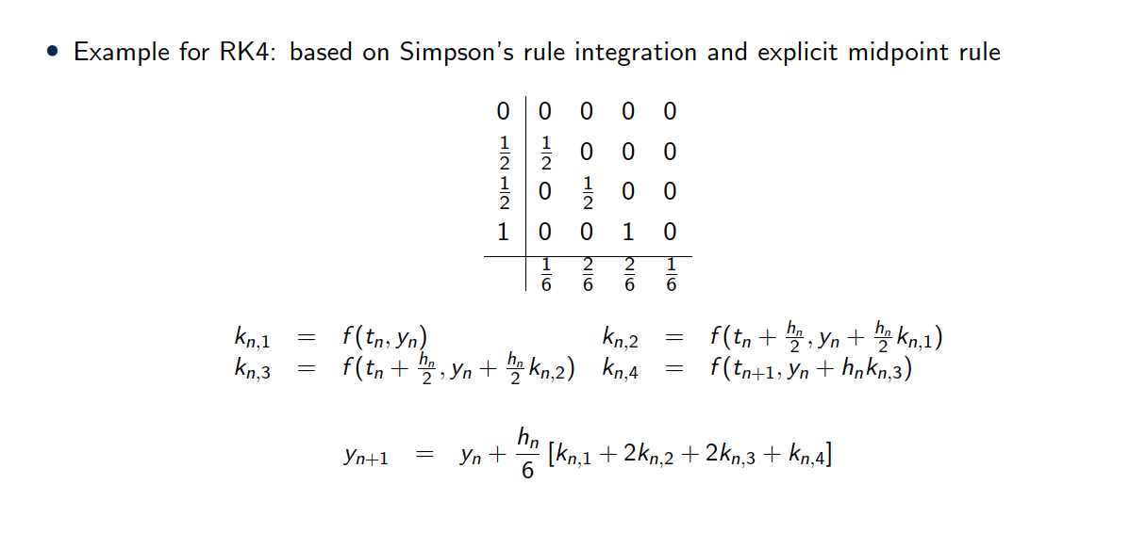


Runge Kutta 4 (RK4)

Slide 48
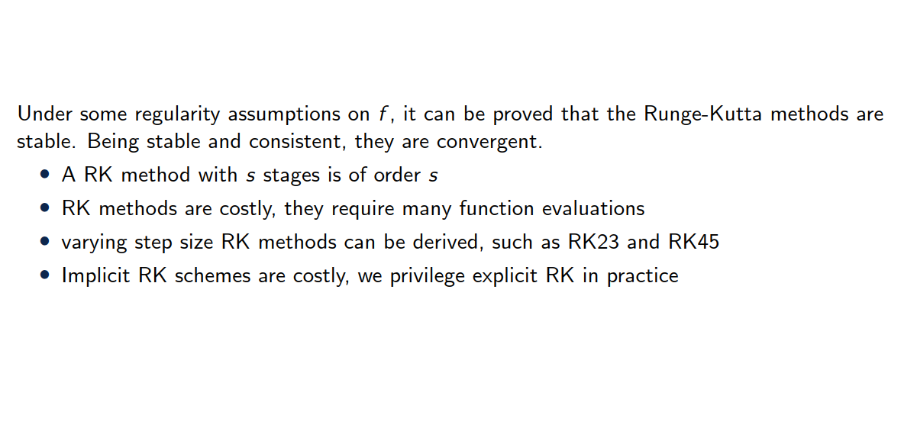
Remarks on Runge Kutta

Slide 49
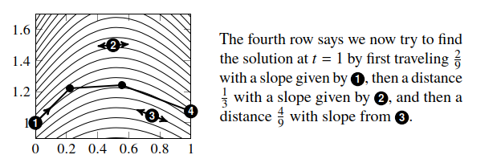
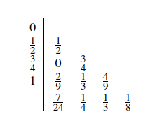
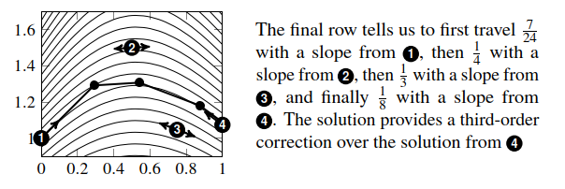

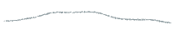













Butcher Tableau - interpretation

Slide 50
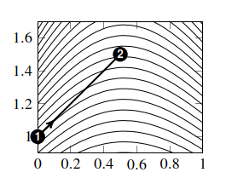
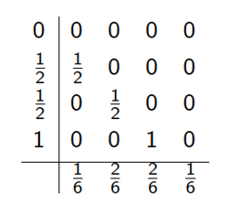

























RK4 - interpretation

Slide 51















RK4 - interpretation

Slide 52

Adaptive step size
One advantage of RK methods is that step size can be varied
With an error estimator this allows to use smaller steps to minimize errors and maintain stability
Often, a RK method embeds a lower-order method inside a higher-order method,
sharing the same Butcher tableau!
For example, the Bogacki–Shampine method (Python "RK23“, Matlab ode23, Julia’s BS3) combines a 2nd and 3rd order Runge–Kutta method using the same quadrature points
The notation RK𝑚𝑛 is occasionally used
𝑚 is the order to obtain the solution
𝑛 is the order of the method to obtain the error estimate
Bogacki–Shampine

Slide 53


RK2, RK4 and RK23 (explicit)
We travel h/2 with slope from 1
We travel h with slope from 2
Bogacki–Shampine
Exercise 3 - pendulum

Slide 54



[][

Slide 55
4. Multi-step methods

Slide 56

Adams-Bashforth methods with r + 1 steps

Slide 57

Newton formula (incrementally build polynomials) - interpolation

Slide 58

Adams-Bashforth methods with r + 1 steps

Slide 59

The Adams-Bashforth methods with r + 1 steps

Slide 60

The Adams-Bashforth methods with r + 1 steps

Slide 61

The Adams-Bashforth methods with r + 1 steps

Slide 62

The Adams-Bashforth methods with r + 1 steps

Slide 63

The Adams-Bashforth methods with r + 1 steps

Slide 64

The Adams-Bashforth methods with r + 1 steps

Slide 65

The Adams-Bashforth methods with r + 1 steps

Slide 66

The Adams-Bashforth methods with r + 1 steps

Slide 67

The Adams-Moulton methods with r + 1 steps

Slide 68

The Adams-Moulton methods with r + 1 steps

Slide 69

The Adams-Moulton methods with r + 1 steps

Slide 70

Predictor-Corrector methods

Slide 71

Predictor-Corrector methods

Slide 72

Predictor-Corrector methods

Slide 73

Backward differentiation formula

Slide 74

Backward differentiation formula

Slide 75
5. Additional considerations

Slide 76

Stiﬀ equations
A solution is said to be stiff if the dynamics of the solution react on at least two vastly diﬀerent time scales
Example: diﬀusion equations are stiff
The solution evolves quickly in the presence of a large spatial gradient and then slows to a crawl once it smooths out.
Advanced schemes (adaptive and implicit) are required for such problems

Slide 77

Non-linear problems
Explicit is no-brainer, you simply evaluate the function at previous time step (like if linear)
No iterative solver like Newton-Raphson is used because explicit methods avoid solving systems of equations.
However, stability imposes some restrictions on the time step (CFL condition in hyperbolic problems)
Implicit
To solve the resulting non-linear system, you perform inner iterations: Start with an initial guess (usually the solution from the previous step).
Apply a non-linear solver (e.g., Fixed point or Newton-Raphson), which involves solving linearized systems iteratively until convergence.
Update the solution and repeat until the residual meets the tolerance.

Slide 78
Implicit or Explicit?
Stiffness: Implicit schemes are preferred for stiff problems as explicit schemes can require impractically small time steps.
Computational cost: Implicit schemes are more expensive per step due to the inner iterations, but fewer time steps may offset this cost.
Accuracy: Both schemes can achieve high accuracy if the time step is small, but implicit methods often allow larger steps without losing stability.
Inner iterations: In implicit schemes, the non-linear solver (e.g., Newton-Raphson) introduces another layer of convergence:
Each non-linear iteration linearizes the problem around the current guess (Fixed point or Newton).
Inner convergence depends on the problem's non-linearity and the initial guess.
Exercise 4 – 2 mass & spring
Exercise 5 – spaceship

Slide 79
6. Summary

Slide 80

Summary

